Slide 1
EECS 2510 Non-Linear Data Structures and Programming in C++
Spring 2018
Lecture 24 – Chapter 25 – Shortest Paths (Single Source)
Dr. Larry G. Thomas – University of Toledo/LCCC

Slide 2
Shortest Paths - Introduction
Chapter 24 introduced us to algorithms for single-source shortest paths.
In this chapter, we consider all-source shortest paths (i.e., the shortest path from every vertex to every other vertex)
We could use the single-source algorithms |V| times (single-sourced once from each of the |V| vertices)

Slide 3
Shortest Paths – Introduction (2)
Using the Chapter 24 algorithms:
If there are no negative weights, we can use Dijkstra’s algorithm
If we implement the min-priority queues using linear arrays, Dijkstra would require: V * O(V ²+E) → O(V ³+VE) → O(V ³)
A binary min-heap priority queue requires O(VE lg V)
VE lg V is better than V ³ if the graph is sparse
A Fibonacci heap gets us to O(V ² lg V+VE)

Slide 4
Shortest Paths – Introduction (3)
If there are negative weights, we can’t use Dijkstra’s algorithm at all!
If we use Bellman-Ford, the run-time is O(V ²E). If the graph is dense, then |E| approaches |V ²|, so the run time becomes O(V ⁴).
We can do better, and without fancy data structures (like Fibonacci heaps)!

Slide 5
Shortest Paths – Introduction (4)
The single-source algorithms handled the sets of edges as lists
We will now switch to using an adjacency matrix representation
Rather than starting at zero, we will number the vertices starting at 1, going through |V|
The input to our algorithm is an n × n matrix W representing the edge weights of an n-vertex directed graph G = (V, E)

Slide 6
Shortest Paths – Introduction (5)
W = (w_{ij}), where
Negative-weight edges are allowed, but for now, assume that negative-weight cycles are not

Slide 7
Shortest Paths – Introduction (6)
The output of our algorithms includes another n × n matrix D = (d_{ij}), where each d_{ij} is the weight of a shortest path from vertex i to vertex j.
If δ(i, j) denotes the shortest path from vertex i to vertex j, then d_{ij} = δ(i, j) when the algorithm finishes.

Slide 8
Shortest Paths – Introduction (7)
Not only do we output the shortest-path distance matrix D, we also need to know the paths themselves from / to all vertices.
This requires a predecessor matrix Π = (π_{ij}) where π_{ij} is NIL if either i = j or there is no path from i to j.
Otherwise, π_{ij} is the predecessor of j on some shortest path from i.

Slide 9
Shortest Paths – Introduction (8)
Just as G_{π} was the predecessor graph (created by the V_{π} and E_{π} sets), which gave the tree rooted at our source vertex s, each row of Π (the i^{th} row) is the shortest-path graph rooted at vertex i
There’s a single tree starting at each vertex, so if we start from all vertices, there will be |V| trees.
Notes:
9

Slide 10
Shortest Paths – Introduction (9)
Printing the shortest path from vertex i to vertex j in the all-pairs context is handled similarly to the single-source version
We start at vertex j and work backwards towards i.
Rather than having a list or set of vertices, we use the i^{th} row of the Π (predecessor) matrix
Notes:
10

Slide 11
Printing the Shortest Paths
Print-All-Pairs-Shortest-Path(Π, i, j)
1 if i == j
2 print i
3 else if π_{ij} == nil
4 print "no path from " i " to " j " exists"
5 else Print-All-Pairs-Shortest-Path(Π, i, π_{ij})
6 print j
Notes:
11

Slide 12
Next Steps
We’re going to use dynamic programming (Chapter 15, which we didn’t cover) to develop a method that runs in Θ (V ⁴) time, and then improve it to Θ(V ³lgV)
Notes:
12

Slide 13
Dynamic Programming
Three steps in a dynamic programming approach (see Ch. 15 for background):
1. Characterize the structure of an optimal solution
2. Recursively define the value of an optimal solution
3. Compute the value of an optimal solution in a bottom-up fashion
Note: this is not the same as divide-and-conquer, in which we divide the problem into smaller sub-problems, solve those, and then assemble the “sub-solutions” into the “whole solution”
Notes:
13

Slide 14
The Structure of a Shortest Path
Step 1: Characterize the structure of an optimal solution
We proved (in Chapter 24) that all subsets of a shortest path are also shortest paths
Suppose the graph is represented by an adjacency matrix W
Consider the shortest path p from i to j, with no more than m edges
If there are no negative-weight cycles, then m is finite
Notes:
14

Slide 15
The Structure of a Shortest Path (2)
#1: Characterize the structure of an optimal solution
Since m is finite, we can break the path down:
If i = j, then p has weight 0 and no edges
Otherwise, we can decompose the path p from i to j into a path from i to some intermediate vertex k and then a single edge from k to j
p' contains m – 1 edges, and δ(i, j) = δ(i, k) + w_{kj}
Notes:
15

Slide 16
A Recursive Solution
Let l_{ij}^{(m)} be the minimum weight of any path from vertex i to vertex j that contains at most m edges.
When m = 0 (no edges at all), there is a shortest path from i to j iff i = j. Thus:
Notes:
16

Slide 17
A Recursive Solution (2)
When m ≥ 1, we compute l_{ij}^{(m)} as the minimum of l_{ij}^{(m-1)} (the best we can do with m – 1 edges), and the minimum weight of any path from i to j containing at most m edges, obtained by looking at all possible predecessors k of j
Notes:
17

Slide 18
A Recursive Solution (3)
When m ≥ 1:
(since w_{jj} = 0 for all j)
Notes:
18

Slide 19
A Recursive Solution (4)
A less-than-obvious side-effect of this definition:
If there are no negative-weight cycles, then the maximum length path from i to j (assuming that a path exists at all) will contain no more than (n – 1) edges (where n = |V|, of course)
Notes:
19

Slide 20
Compute Solution Bottom-Up
Given our input matrix W = (w_{ij}), we now compute a series of matrices:
L⁽¹⁾, L⁽²⁾, …, L^{(n – 1)} where for m = 1, 2, …, (n – 1), we have L^{(m)} = (l_{ij}^{(m)})
Note that l_{ij}⁽¹⁾ = w_{ij} for all i, j ∈ V, so L⁽¹⁾ = W
Notes:
20

Slide 21
The Algorithm to Do This
Given matrices W and L^{(m – 1)}, compute L^{(m)}
In other words, extend the shortest paths computed so far by one edge.
Notes:
21

Slide 22
Extend-Shortest-Paths Algorithm
Extend-Shortest-Paths(L, W)
1 n = L.rows
2 let L' = (l'_{ij}) be an n × n matrix
3 for i = 1 to n
4 for j = 1 to n
5 l'_{ij} = ∞
6 for k = 1 to n
7 l'_{ij} = min(l'_{ij}, l_{ik} + w_{kj})
8 return L'
Run Time:
Θ(n³)
Notes:
22

Slide 23
Compared to Matrix Multiplication
The product of two matrices C = A•B of two n × n matrices A and B can be computed by
Substituting: l ^{(m – 1)} → a
w → b
l^{(m)} → c
min → +
+ → ⋅
∞ → 0 (identities)
Notes:
23

Slide 24
Matrix-Multiply Algorithm
Matrix-Multiply(A, B)
1 n = A.rows
2 let C = (c_{ij}) be an n × n matrix
3 for i = 1 to n
4 for j = 1 to n
5 c_{ij} = 0
6 for k = 1 to n
7 c_{ij} = c_{ij}+ (a_{ik} ⋅ b_{kj})
8 return C
Notes:
24

Slide 25
Back to Shortest Paths
We compute the shortest paths by extending the shortest paths edge-by-edge.
If we let A⋅ B denote the “product” from Extend-Shortest-Paths(A, B), then the computation of our n – 1 matrices is:
L⁽¹⁾ = L⁽⁰⁾ ⋅ W = W
L⁽²⁾ = L⁽¹⁾ ⋅ W = W ⋅ W = W ²
L⁽³⁾ = L⁽²⁾ ⋅ W = W ⋅ W ⋅ W = W ³
…
L^{(n-1)} = L^{(n-2)} ⋅ W = W ^{(n-1)}, ⇒ the shortest-path weights
Notes:
25

Slide 26
Slow-All-Pairs-Shortest-Paths
Slow-All-Pairs-Shortest-Paths(W)
1 n = W.rows
2 L⁽¹⁾ = W
3 for m = 2 to (n – 1)
4 L^{(m)} = Extend-Shortest-Paths(L^{(m–1)}, W)
5 return L^{(n–1)}
Run Time:
Θ(n⁴)
Notes:
26

Slide 27
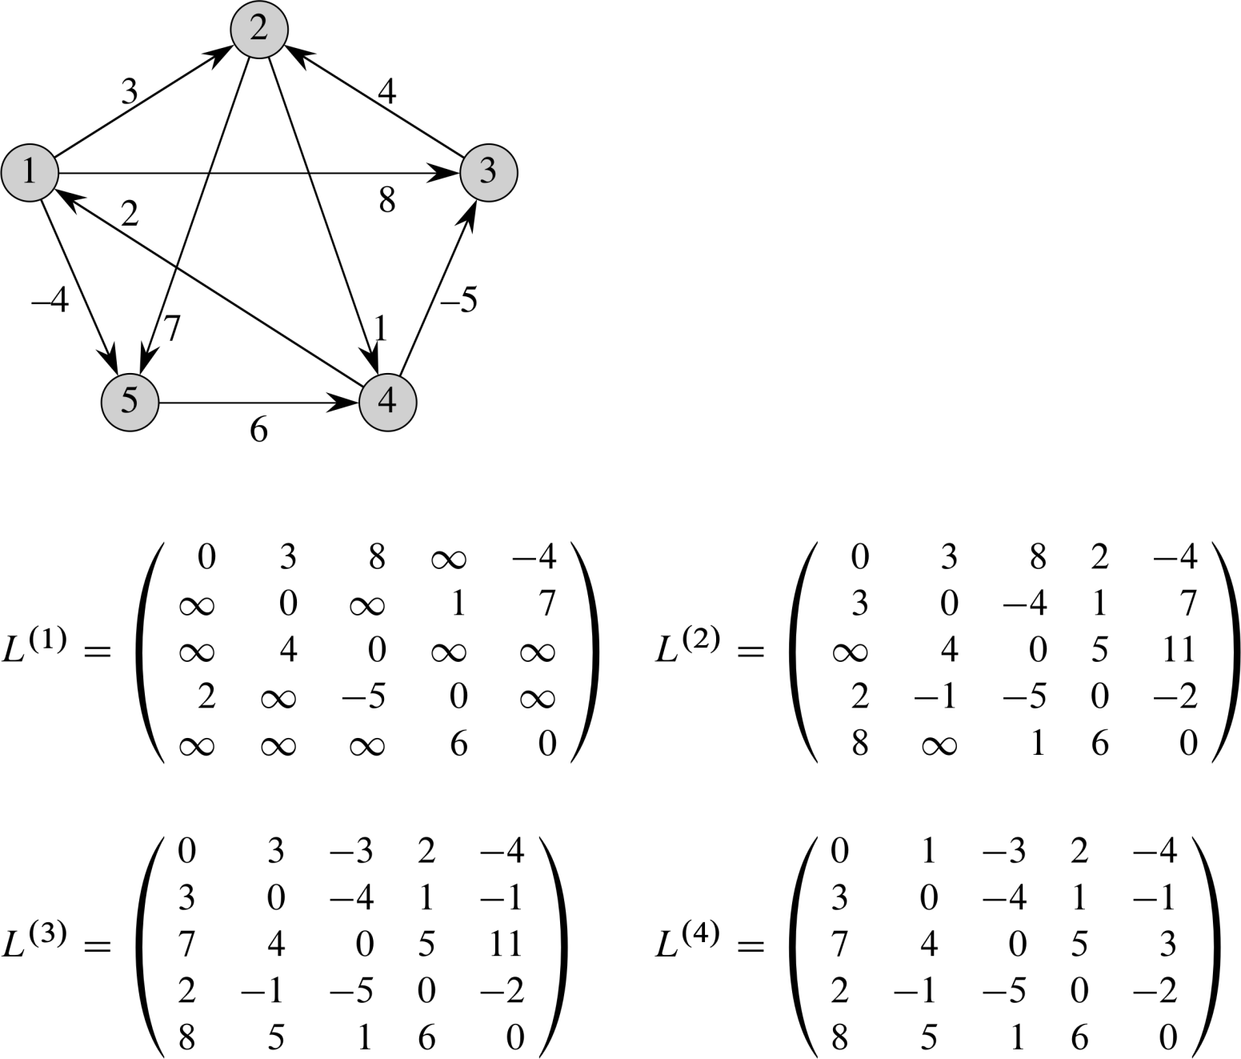
Example – Fig 5.1
You should compute L⁽⁵⁾, to verify that L^{(m)} = L^{(n – 1)}
for all m ≥ (n – 1)
Notes:
27

Slide 28
If That’s the Slow Way, …
…Then how can we speed up the process?
First, we don’t need ALL of the intermediate matrices used in calculating the L^{(n – 1)} matrix; just that last (n – 1)^{th} one.
Second, we said that the shortest path has no more than (n – 1) edges
Notes:
28

Slide 29
If That’s the Slow Way, …(2)
Third, we said that L^{(m)} = L^{(n – 1)} ∀ m ≥ n – 1
This has huge implications!
If L_{ij}^{(m)} is the matrix containing the shortest path lengths from each i to j, with each path containing no more than m edges, and we don’t need any more than (n – 1) edges to represent the shortest path, then it doesn’t matter how large m is (as long as m ≥ n – 1)
Notes:
29

Slide 30
If That’s the Slow Way, …(3)
Let’s put some numbers on this idea
Suppose our graph has 10 nodes.
If the shortest path from i to j has n – 1 (i.e, 9) edges, then the shortest path from i to j containing no more than 1,000,000 edges is still that same 9-edge path!
No shortest path can use more than n – 1 edges, so if it can’t use more than 9, it can’t use more than 10, or 11, or 1,000,000.
The implication is that we can over-shoot n – 1, and we don’t lose anything.
Why would we possibly want to do more matrix multiplications than necessary?
We don’t, but there’s a way to avoid many of them.
Notes:
30

Slide 31
If That’s the Slow Way, …(4)
[Aside]
How do we compute x¹⁰²⁴?
We can perform 1023 multiplications: x * x * x * x * x * x * x …
Or we can compute:
y = x * x y = x²
z = y * y z = x⁴
q = z * z q = x⁸
p = q * q p = x¹⁶
r = p * p r = x³²
s = r * r s = x⁶⁴
… ? = x¹⁰²⁴ 10 multiplications gives us x¹⁰²⁴
Notes:
31

Slide 32
If That’s the Slow Way, …(5)
"The implication is that we can over-shoot n – 1, and we don’t lose anything"
Why would we possibly want to do more than the n – 1 matrix multiplications?
We don’t!! We want to do as few as possible!!
Suppose we want L⁽⁸⁾, (i.e., we have 9 vertices)
Rather than computing W⋅W⋅W⋅W⋅W⋅W⋅W⋅W, why not compute A = W⋅W, and then B = A⋅A, and then C = B⋅B (i.e., A = W ², B = W ⁴, and C = W ⁸)?
That gets us L⁽⁸⁾ with only 3 matrix multiplications!
Notes:
32

Slide 33
If That’s the Slow Way, …(5)
Suppose we want L⁽²⁰⁾, (i.e., |V| = 21)
Using successive squaring, we can get to L⁽¹⁶⁾ in four matrix multiplications, and we can then use four more to get from L⁽¹⁶⁾ to L⁽²⁰⁾ (eight in all).
But we said we can overshoot m and not lose anything!
So, we compute L⁽³²⁾ in 5 matrix multiplications, knowing that L⁽³²⁾ is L⁽²⁰⁾ (when |V| = 21)
Our run time is now Θ(n³ lg n)
Θ(n³) per matrix multiply, times Θ(lg n) of them
Notes:
33

Slide 34
Yet Another Way
Another dynamic programming algorithm
Floyd-Warshall runs in Θ(n³) time
Allows negative-weight edges, but no negative-weight cycles (as before)
We define the intermediate vertices of a path p between vertices i and j as all vertices along p except for vertices i and j.
Notes:
34

Slide 35
Yet Another Way (2)
Observe: if V = {1, 2, …, n}, consider some k-sized subset, {1, 2, …, k}
For any pair of vertices i, j ∈ V, consider all paths from i to j whose intermediate vertices are all drawn from {1, 2, …, k}, and let p be a (simple) minimum-length path among them
“Drawn from” doesn’t necessarily mean we need all of them
Notes:
35

Slide 36
Yet Another Way (3)
If the k^{th} vertex in {1, 2, …, k} is not an intermediate vertex of p, then we only need {1, 2, …, k – 1}.
So, a shortest path from i to j with all of its intermediate vertices in {1, 2, …, k – 1} is also a shortest path with all of its intermediate vertices in {1, 2, …, k}
Notes:
36

Slide 37
Yet Another Way (4)
If the k^{th} vertex in {1, 2, …, k} is an intermediate vertex of p, then we can break p down into:
By Lemma 24.1, p₁ is a shortest path from i to k with all intermediate vertices in {1, 2, …, k}.
Because k is not an intermediate vertex of p₁, p₁ is a shortest path from i to k with all intermediate vertices in {1, 2, …, k–1}.
Similarly, p₂ is a shortest path from k to j with all intermediate vertices in {1, 2, …, k–1}.
Notes:
37

Slide 38
Recursive Solution (D.P. Step #2)
Let d_{ij}^{(k)} be the weight of a shortest path from i to j in which all intermediate vertices come from {1, 2, …, k}
If k = 0, then a path from i to j has no intermediate vertices at all, so it has, at most, a single edge: d_{ij}⁽⁰⁾ = w_{ij}. Thus:
Notes:
38

Slide 39
Recursive Solution (D.P. Step #2)
Since there are only n vertices, the matrix D^{(n)} = (d_{ij}^{(n)}) holds the final result:
d_{ij}^{(n)} = δ(i, j) for all i, j ∈ V
Notes:
39

Slide 40
Bottom-Up Computation (D.P. Step #3)
Floyd-Warshall(W)
1 n = W.rows
2 D⁽⁰⁾ = W
3 for k = 1 to n
4 for i = 1 to n
5 for j = 1 to n
6 d_{ij}^{(k)} = min(d_{ij}^{(k – 1)}, d_{ik}^{(k – 1)} + d_{kj}^{(k – 1)})
7 return D^{(n)}
Run Time:
Θ(n³)
Notes:
40

Slide 41
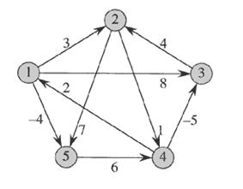
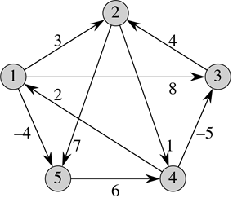
Floyd-Warshall Example
Notes:
41

Slide 42
Constructing the Shortest Path
Another recursive definition (for the predecessors):
See fig. 25.4
Notes:
42

Slide 43
Transitive Closure of a Graph
Given a directed graph G = (V, E), with vertex set V = {1, 2, …, n}, how do we determine if there is some path from vertex from i to j for all vertex pairs i, j ∈ V ?
The transitive closure of G is the graph G* = (V, E*), where E* = {(i, j) : there is a path from vertex i to vertex j in G}
How many edges can there possibly be in E* ?
How to determine the transitive closure?
Notes:
43

Slide 44
Determining the Transitive Closure
One way is to set all of the weights w_{ij} to either 1 (if there is an edge between i and j) or ∞ (if there isn’t) and then run Floyd-Warshall.
That will leave all path lengths d_{ij} as either:
∞ (no path at all from i to j), or …
Some positive integer less than n (if there is)
Notes:
44

Slide 45
Determining the Transitive Closure
Another, similar way is to use single bits, rather than weights, and use the logical operations AND (∧) and OR (∨), rather than the arithmetic operations + and min.
Using logical operations on booleans may be faster and more space-efficient on some computers than using numeric operators and operands.
Notes:
45

Slide 46
Transitive Closure – Recursive Definition
There’s a path from i to j in the k^{th} iteration if there was a path in the previous iteration, or if there’s a path from i to k and a path from k to j in the previous iteration.
Notes:
46

Slide 47
Transitive Closure – Recursive Definition
Transitive-Closure(G)
1 n = |V(G)|
2 for i = 1 to n
3 for j = 1 to n
4 if i = j or (i, j) ∈ G.E
5 t_{ij}⁽⁰⁾ = 1
6 else t_{ij}⁽⁰⁾ = 0
7 for k = 1 to n
8 for i = 1 to n
9 for j = 1 to n
10 t_{ij}^{(k)} = t_{ij}^{(k–1)} ∨ (t_{ik}^{(k–1)} ∧ t_{kj}^{(k–1)})
11 return T^{(n)}
Notes:
47

Slide 48
Shortest Paths – All Pairs – Once More
Johnson’s Algorithm – O(V ² lg V + VE)
If the graph is dense, then E → V ², so it’s more like V ³.
If the graph is sparse, then (V ² lg V) will dominate, which is better than we’ve seen so far
Notes:
48

Slide 49
Reweighting
If we can come up with an equivalent graph with non-negative edge weights, then we can use Dijkstra’s algorithm, and get all of the benefits (speed), and avoid the one (huge) restriction of no negative weights.
Notes:
49

Slide 50
Reweighting
We need to compute a new weight function such that:
1. For all u, v ∈ V, p is a shortest path from u to v using if and only if p is a shortest path from u to v using
2. For all edges (u, v), (u, v) is non-negative
#1 Gives us an equivalent graph
#2 Makes the edges ≥ 0 (so that we can use Dijkstra)
Notes:
50

Slide 51
Reweighting
We create a new mapping that assigns a value to each vertex, and then compute
(u, v) = w(u, v) + h(u) – h(v)
Book has proof that both properties hold
Notes:
51

Slide 52
Reweighting
How? Create a new graph G' from G
Add a new vertex s to the graph, and add new (directed) edges from s to all existing vertices in G.
Because no edges lead TO s, s can’t possibly participate in any cycles in G
Adding s doesn’t change any shortest paths in G
Notes:
52

Slide 53
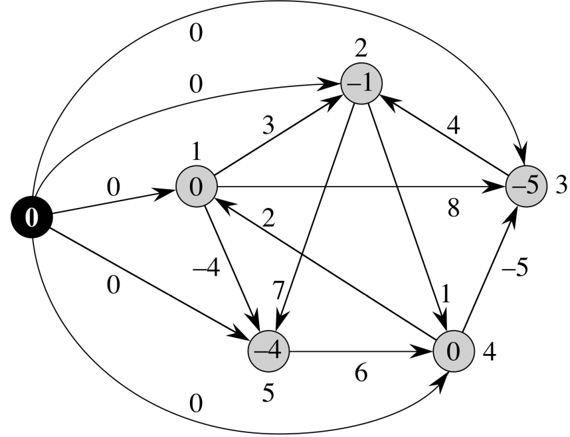
Reweighting
"Add a new vertex s to the graph, and add new (directed) edges from s to all existing vertices in G"
Notes:
53

Slide 54
Johnson’s Algorithm
Johnson’s Algorithm uses Bellman-Ford and Dijkstra as subroutines.
Bellman-Ford is used to tell if we have a negative-weight cycle (it returns false if so)
Then we re-weight the edges (making them non-negative)
Next, we use Dijkstra to get the shortest paths in G'
Finally, we “un-re-weight” the edges to get the shortest paths in G
Notes:
54

Slide 55
Johnson’s Algorithm
Johnson(G, w)
1 Compose G' where G'.V = G.V ∪ {s},
G'.E = G.E ∪ {(s,v): v ∈ G.V}, and w(s, v) = 0 for all v ∈ G.V
2 if Bellman-Ford(G', w, s) = false
3 print “negative cycle present”
4 else for each vertex v ∈ G'.V
5 set h(v) to δ(s, v) from Bellman-Ford
6 for each edge (u, v) ∈ G'.E
7 (u, v) = w(u, v) + h(u) – h(v)
8 let D = (d_{uv}) be a new n x n matrix
8 for each vertex u ∈ G.V
9 run Dijkstra(G, , u) to compute δ'(u, v) for all v ∈ G.V
10 for each vertex v ∈ V[G]
11 d_{uv} = δ'(u, v) + h(v) – h(u)
12 return D
Notes:
55

Slide 56
Johnson’s Algorithm
Johnson(G, w)
1 Compose G' where G'.V = G.V ∪ {s},
G'.E = G.E ∪ {(s,v): v ∈ G.V}, and w(s, v) = 0 for all v ∈ G.V
2 if Bellman-Ford(G', w, s) = false
3 print “negative cycle present”
4 else for each vertex v ∈ G'.V
5 set h(v) to δ(s, v) from Bellman-Ford
6 for each edge (u, v) ∈ G'.E
7 (u, v) = w(u, v) + h(u) – h(v)
8 let D = (d_{uv}) be a new n x n matrix
8 for each vertex u ∈ G.V
9 run Dijkstra(G, , u) to compute δ'(u, v) for all v ∈ G.V
10 for each vertex v ∈ V[G]
11 d_{uv} = δ'(u, v) + h(v) – h(u)
12 return D
Notes:
56

Slide 57
Johnson’s Algorithm
Johnson(G, w)
1 Compose G' where G'.V = G.V ∪ {s},
G'.E = G.E ∪ {(s,v): v ∈ G.V}, and w(s, v) = 0 for all v ∈ G.V
2 if Bellman-Ford(G', w, s) = false
3 print “negative cycle present”
4 else for each vertex v ∈ G'.V
5 set h(v) to δ(s, v) from Bellman-Ford
6 for each edge (u, v) ∈ G'.E
7 (u, v) = w(u, v) + h(u) – h(v)
8 let D = (d_{uv}) be a new n x n matrix
8 for each vertex u ∈ G.V
9 run Dijkstra(G, , u) to compute δ'(u, v) for all v ∈ G.V
10 for each vertex v ∈ V[G]
11 d_{uv} = δ'(u, v) + h(v) – h(u)
12 return D
Use Bellman-Ford to check for negative-weight cycles
Notes:
57

Slide 58
Johnson’s Algorithm
Johnson(G, w)
1 Compose G' where G'.V = G.V ∪ {s},
G'.E = G.E ∪ {(s,v): v ∈ G.V}, and w(s, v) = 0 for all v ∈ G.V
2 if Bellman-Ford(G', w, s) = false
3 print “negative cycle present”
4 else for each vertex v ∈ G'.V
5 set h(v) to δ(s, v) from Bellman-Ford
6 for each edge (u, v) ∈ G'.E
7 (u, v) = w(u, v) + h(u) – h(v)
8 let D = (d_{uv}) be a new n x n matrix
8 for each vertex u ∈ G.V
9 run Dijkstra(G, , u) to compute δ'(u, v) for all v ∈ G.V
10 for each vertex v ∈ V[G]
11 d_{uv} = δ'(u, v) + h(v) – h(u)
12 return D
Re-Weight the edges of G' with the results from Bellman-Ford
Notes:
58

Slide 59
Johnson’s Algorithm
Johnson(G, w)
1 Compose G' where G'.V = G.V ∪ {s},
G'.E = G.E ∪ {(s,v): v ∈ G.V}, and w(s, v) = 0 for all v ∈ G.V
2 if Bellman-Ford(G', w, s) = false
3 print “negative cycle present”
4 else for each vertex v ∈ G'.V
5 set h(v) to δ(s, v) from Bellman-Ford
6 for each edge (u, v) ∈ G'.E
7 (u, v) = w(u, v) + h(u) – h(v)
8 let D = (d_{uv}) be a new n x n matrix
8 for each vertex u ∈ G.V
9 run Dijkstra(G, , u) to compute δ'(u, v) for all v ∈ G.V
10 for each vertex v ∈ V[G]
11 d_{uv} = δ'(u, v) + h(v) – h(u)
12 return D
Use Dijkstra to compute Shortest paths in G'
Notes:
59

Slide 60
Johnson’s Algorithm
Johnson(G, w)
1 Compose G' where G'.V = G.V ∪ {s},
G'.E = G.E ∪ {(s,v): v ∈ G.V}, and w(s, v) = 0 for all v ∈ G.V
2 if Bellman-Ford(G', w, s) = false
3 print “negative cycle present”
4 else for each vertex v ∈ G'.V
5 set h(v) to δ(s, v) from Bellman-Ford
6 for each edge (u, v) ∈ G'.E
7 (u, v) = w(u, v) + h(u) – h(v)
8 let D = (d_{uv}) be a new n x n matrix
8 for each vertex u ∈ G.V
9 run Dijkstra(G, , u) to compute δ'(u, v) for all v ∈ G.V
10 for each vertex v ∈ V[G]
11 d_{uv} = δ'(u, v) + h(v) – h(u)
12 return D
Undo the edge re-weighting
Notes:
60

Slide 61
Johnson’s Algorithm – Run Time
Θ (V+E) to produce G'
Θ (VE) to run Bellman-Ford
Θ (E) to compute
To run Dijkstra |V| times:
O (V ² lg V+VE) if we use Fibonacci heap
O (VE lg V) if we use Binary heap
O (V ²) to compute D matrix
Total: O (V ² lg V+VE) or O (VE lg V)
Dominated by |V| runs of Dijkstra
Notes:
61

Slide 62
End of Chapter 25
? Questions ?
Notes:
62

